Slide 1
Instagram UsER AND LIFESTYLE Analytics
Presented by
E.Gowsalya

Slide 2
Introduction
Instagram usage has increased significantly in recent years. Understanding user behavior helps businesses improve marketing strategies.
This project analyzes Instagram usage, engagement, lifestyle, and business metrics using Power BI.

Slide 3
Problem Statement
Instagram usage is growing rapidly.
The relationship between screen time, followers, and engagement is not clearly understood.
Excessive usage may impact lifestyle factors like sleep and stress. Business metrics such as ad performance and premium user conversion also need analysis.
This project aims to analyze these factors using data analytics.

Slide 4
Business Questions
Screen time vs. engagement
Impact of high usage on stress
Gender-based engagement comparison
Country-level user distribution
Advertising effectiveness
Screen time vs. stress score

Slide 5
Data Overview
Demographics (Age, Gender, Country)
Usage Metrics (Daily Active Minutes, Sessions)
Engagement Metrics (Likes, Comments)
Business Metrics (Ads Viewed, Ads Clicked, Premium Users)
Lifestyle Metrics (Sleep Hours, Stress Score)

Slide 6
Data Fields
Important Columns:
daily_active_minutes_instagram
sessions_per_day
likes_given_per_day
comments_written_per_day
followers_count
perceived_stress_score
sleep_hours_per_night
ads_viewed_per_day
ads_clicked_per_day
subscription_status

Slide 7
Technology Used
Data Source: Instagram Lifestyle Dataset
Data Cleaning: Power Query
Data Modeling: Power BI Relationships
Data Analysis: DAX Measures
Visualization: Power BI Dashboard

Slide 8
Data Preprocessing
Data cleaned using Power Query
Removed duplicate records
Corrected data types
Created Usage Category (Low / Medium / High)
Created DAX Measures for KPIs

Slide 9
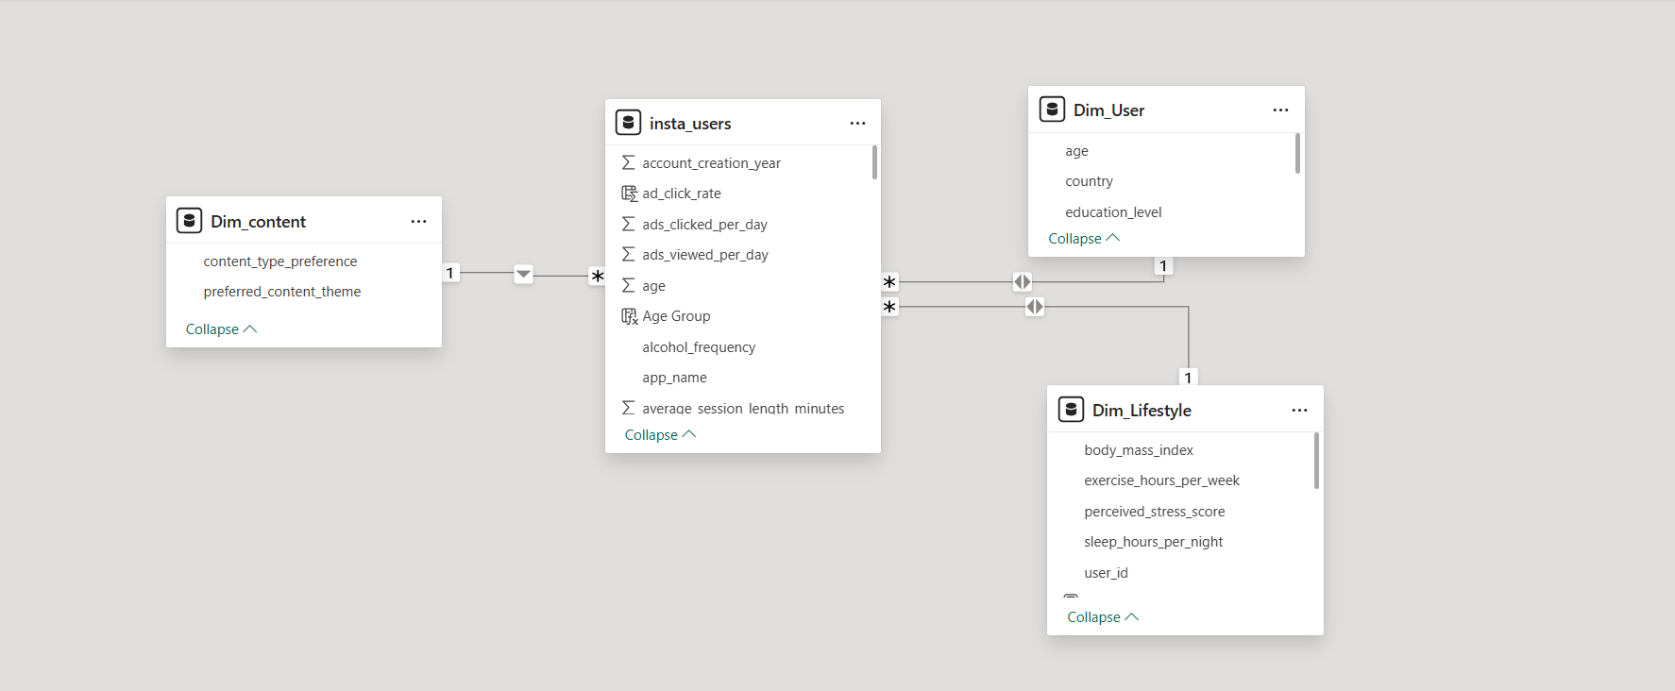
Data Modeling Overview
Single table model (insta_users)
Created calculated columns
Built measures for KPIs
Optimized relationships

Slide 10
DAX Measures Overview
Total Users = DISTINCTCOUNT(user_id)
Average Screen Time = AVERAGE(daily_active_minutes_instagram)
Ad Click Rate = SUM(ads_clicked_per_day) / SUM(ads_viewed_per_day)
Average Daily Usage = AVERAGE(insta_users[daily_active_minutes_instagram])
Avg Sessions Per Day = AVERAGE(insta_users[sessions_per_day])

Slide 11
Key KPIs
• Total Users
• Average Daily usage
• High Usage Users Percentage (>180 minutes)
• Average Engagement Score
• Engagement per Session
• Ad Click Rate Percentage
• Average Stress Score and Sleep Hours

Slide 12
Dashboard Visualizations
Column Chart - Age Group vs Average Daily Usage
line Chart - Engagement by Content Type
Map Chart - Country-wise User Distribution
Line chart - Average Engagement by Followers Count
Clustered column chart - Engagement by Followers Category
Clustered bar chart - Screen Time vs Stress Score
Clustered bar chart - Total Engagement by Gender
Donut Chart – Ad view distribution

Slide 13
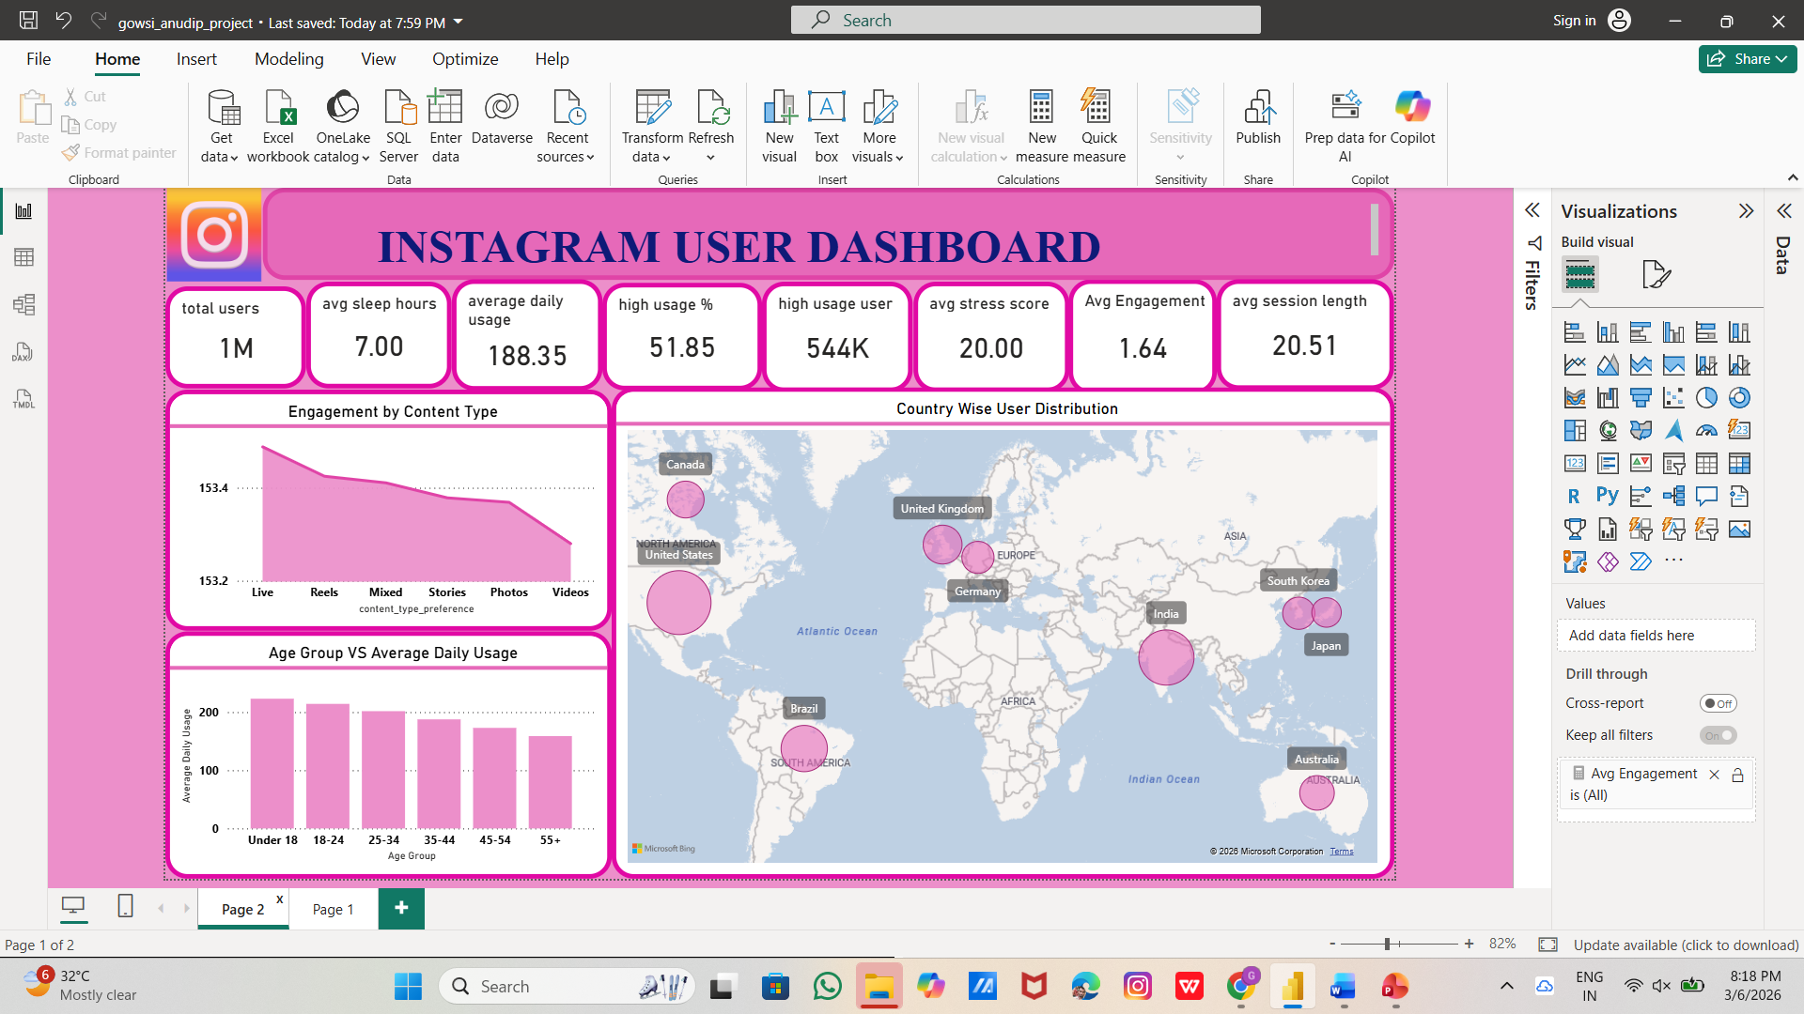
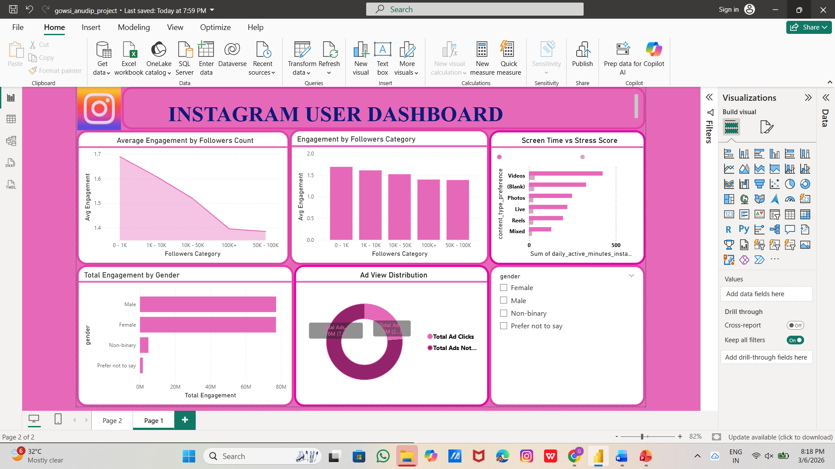
Dashboard Visual 2

Slide 14
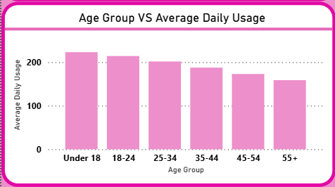
Age Group vs Average Daily Usage
This chart shows the relationship between age group and average daily Instagram usage.
Younger users (Under 18 and 18–24) spend more time on Instagram, while usage gradually decreases as age increases, with 55+ users having the lowest screen time.

Slide 15
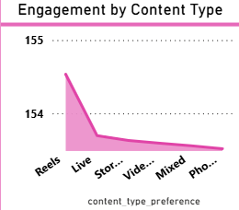
Engagement by content type
This chart shows engagement levels across different content types on Instagram.
Reels generate the highest engagement, while other formats like Live, Stories, and Photos show comparatively lower interaction levels.

Slide 16
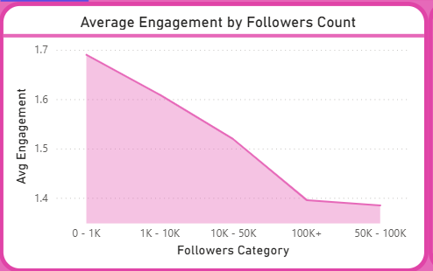
Average Engagement by Followers Count
This line chart shows the relationship between followers count and average engagement.
While users with more followers generally have higher engagement, some users with fewer followers also achieve strong engagement, indicating high content effectiveness.

Slide 17
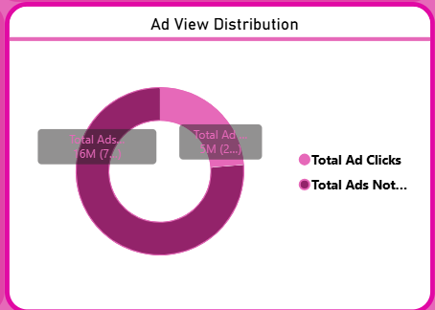
Ad view distribution
This donut chart shows the proportion of total ads clicked versus total ads not clicked.
The majority of ads are not clicked, indicating a lower overall ad click rate compared to total ad views.

Slide 18
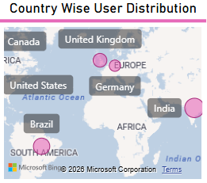
Country wise user distribution
This chart shows the distribution of Instagram users across different countries.
It helps identify regions with higher user concentration, supporting targeted marketing and regional growth strategies.

Slide 19
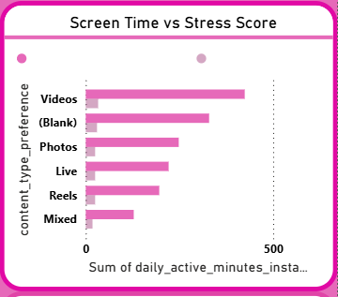
Screen time vs stress score
This clustered bar chart shows the relationship between daily screen time and perceived stress score.
It indicates that users with higher screen time tend to report higher stress levels, suggesting a possible link between excessive usage and increased stress.

Slide 20
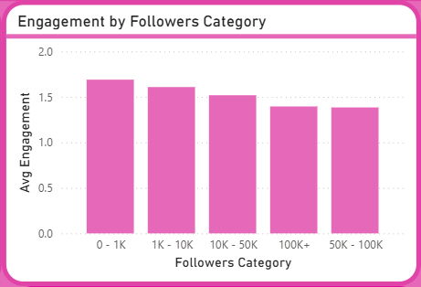
Engagement by Followers Category
This chart shows the average engagement levels across different followers count categories. It indicates that users with fewer followers (0–1K) have slightly higher engagement rates, while engagement gradually decreases as follower count increases.

Slide 21
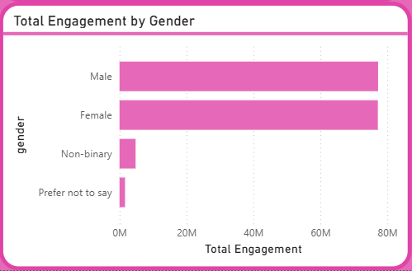
Total Engagement by gender
This chart compares the total engagement levels across different gender groups on Instagram. It shows that male and female users contribute the highest engagement, while other gender categories have relatively lower interaction levels.

Slide 22
Conclusion
This dashboard provides insights into Instagram user behavior. It helps understand engagement patterns and lifestyle impact. The project supports data-driven decision-making for business and marketing strategies.

